Slide 1
Storage Consistency in Distributed Systems Alejandro Flores & Husain Al Yusuf
UNM College of Engineering

Slide 2
Agenda
Storage Consistency
Storage Consistency in Distributed Systems
Consistency, Performance, & Availability
Guarantee classes for reading operations
Analogy of consistency guarantee classes
Real Word Application
Conclusion

Slide 3
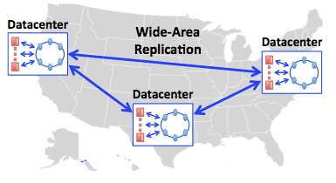
What is Storage Consistency ?

Slide 4
What is the Problem ?
Need
Data Availability
Geographically Distributed Customers
Install
Geographically Distributed Datacenters
Storage Distribution
Problem
Inconsistent Read/Write Operations

Slide 5
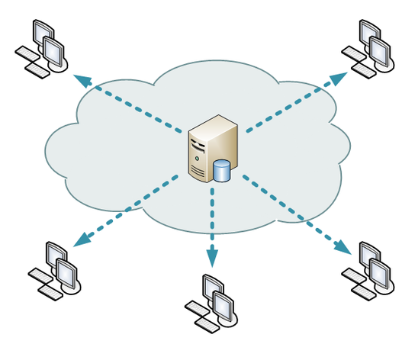

What is the Problem ? Cont.
Canada
UK
California
China
Brazil

Slide 6
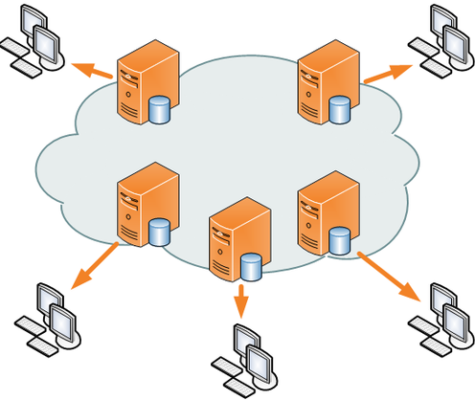
What is the Solution ?
Canada
UK
California
China
Brazil

Slide 7
Consistency vs Performance vs Availability
Strength of Consistency Guarantees
Consistency
Performance
Availability
Successful Read with Storage Failure
Read Operation Latency

Slide 8
Strength of Consistency Guarantees
“The strength of consistency guarantee does not depend when and how writes propagate between servers but rather is defined by the size of the set of allowable results for a read operation. “

Slide 9
Classes of Reading Operations
Strong Consistency
Eventually Consistency
Consistent Prefix
Bounded Staleness
Monotonic Reads
Read My Writes

Slide 10
Classes of Reading Operations
Strong Consistency (Read Latest Value)
Guarantees a read operation returns the value that was last written for a give object.
Read observes the effects of all previously completed writes.

Slide 11
Classes of Reading Operations
Eventually Consistent (Worst Consistency)
Read operations can return any value for a data object that was written in the past.
Possible result of read operation are subset of previous writes.
If the client stops performing writes the read operation would eventually return an object’s latest value.

Slide 12
Classes of Reading Operations
Consistency Prefix (Snapshot)
Reader operation takes a snapshot of an object.
Reader sees one specific valid version out of multiple versions in the data store
Best option when:
reading multiple data objects.
write operations incrementally update an object.

Slide 13
Classes of Reading Operations
Bounded Staleness (Not Older Than T Minutes)
Ensures read results are NOT too out of date.
Bound the result of read operation to be NOT older than T amount of time.

Slide 14
Classes of Reading Operations
Monotonic Reads (Session Guarantee)
Multiple read operation in one session.
Later read operation will return same or more recent value.
Best option when
sequence of read operations performed by same client .

Slide 15
Classes of Reading Operations
Read My Writes (Read My Latest Writes)
Becomes “Strongly Consistency” if read operation is performed on object that WAS written by the same client.
Becomes “Eventual Consistency” if read operation is performed on object the WAS NOT written by the same client.
Best option when
Sequence of read/write operations performed by a single client .

Slide 16


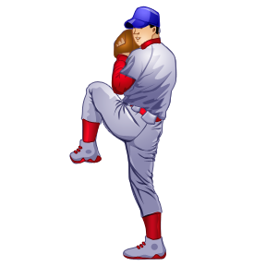
Let’s Play
Baseball

Slide 17
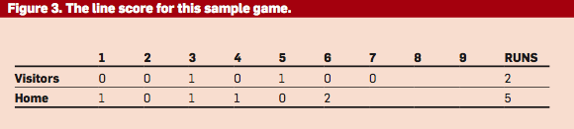
Baseball Analogy
Read current score
+1 to current score.
Write new score

Slide 18
Baseball Analogy
Official Scorekeeper
Umpire
Radio Reporter
Sportswriter
Statistician
Stat Watcher

Slide 19
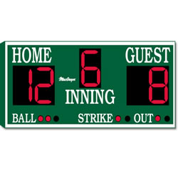
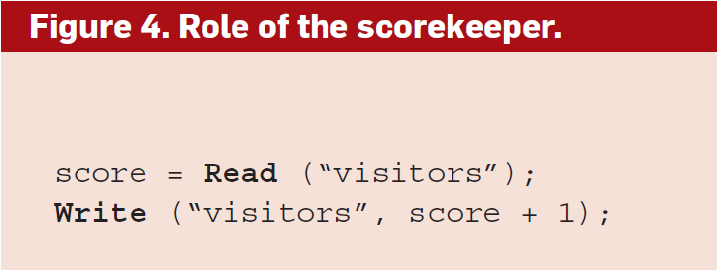
Official Scorekeeper
Requirements:
Read the most up-to-date previous score before
Then Write the new score.
Consistency Guarantee Option(s):
Strong consistency
Read my write

Slide 20
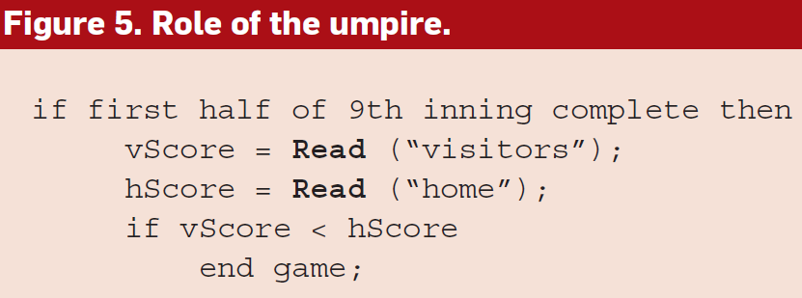
Umpire
Requirements:
Access the score in the top half of the 9th inning (last inning).
Consistency Guarantee Option(s):
Strong consistency read

Slide 21

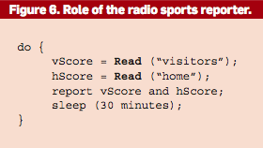
Radio Sports Reporter
Requirements:
Might need to report every 30 minutes but does not have to be the latest score.
Consistency Guarantee Option(s):
Monotonic reads & Consistency prefix
Bounded staleness read with bound of 30 min or less.

Slide 22

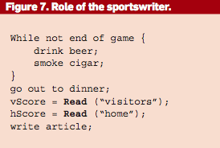
Sportswriter
Requirements:
Does not need the latest score but does need to report accurate final score.
Consistency Guarantee Option(s):
Strong consistency (Too expensive).
Bounded staleness read bounded by an hour. In theory any server should be able to provide final scores.
Potentially eventual consistency might work too.

Slide 23
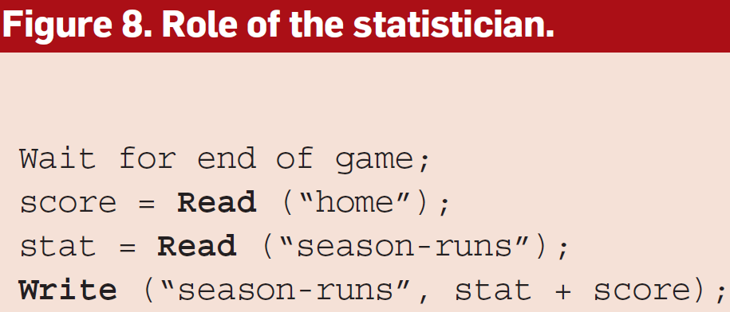
Statistician
Requirements:
Keeping track of season long statistics for the team and individual players. Must enter current seasons score to previous season total.
Consistency Guarantee Option(s):
Strong consistency read
Bounded staleness read
Read my Write

Slide 24

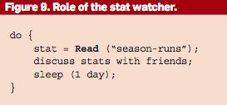
Stat Watcher
Requirements:
Periodically checks on team’s seasons statistics.
Consistency Guarantee Option(s):
Eventually consistency

Slide 25
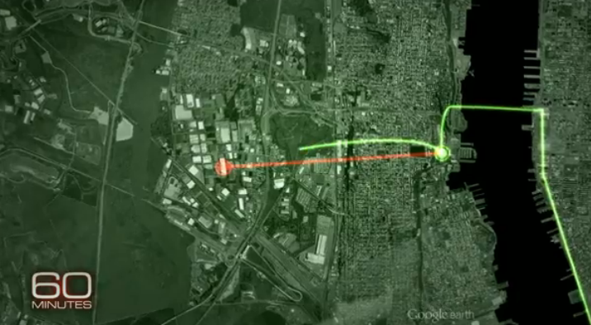
Real World Application

Slide 26
Paper Conclusion
There are more consistency guarantees besides the one listed in the paper.
The ideas was to provide accurate results by balancing performance and availability.
Note that multiple consistency can be used to achieve the goal.
The correct consistency guarantee should be based on the client needs.

Slide 27
References
By Doug Terry…
“Replicated Data Consistency Explained Through Baseball”,
From Communication of the ACM, December 2013

Slide 28
Any Questions ?

